Slide 1
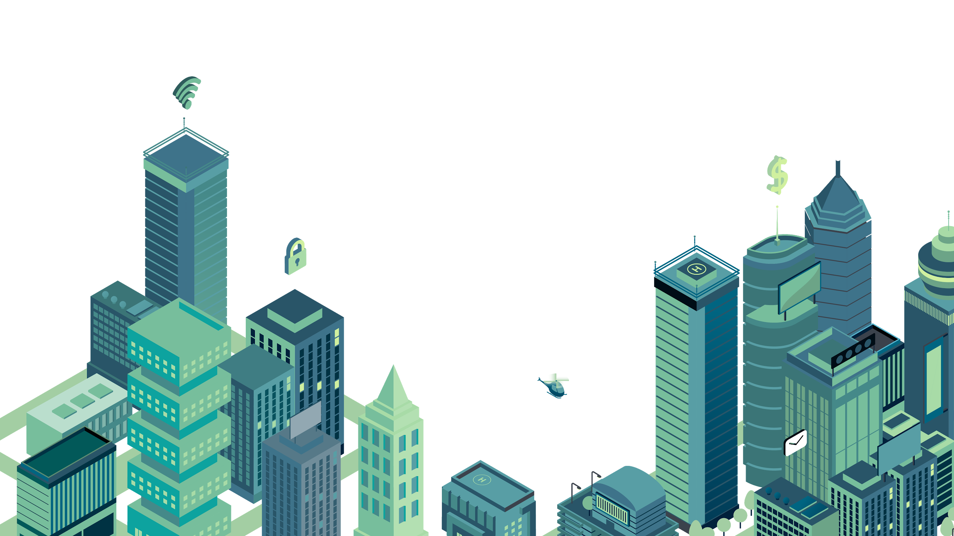
smart city meeting
Here is where your presentation begins

Slide 2
meeting objectives
Venus has a beautiful name, but it’s terribly hot
Despite being red, Mars is a cold place, not hot
Jupiter is the biggest planet in our Solar System

Slide 3
agenda
Project Schedule
Project Timeline
Status Report
Upcoming Report
Here you could describe the topic of the section
Here you could describe the topic of the section
Here you could describe the topic of the section
Here you could describe the topic of the section

Slide 4

about the project
Mercury is the closest planet to the Sun and the smallest one in our Solar System—it’s only a bit larger than our Moon. The planet’s name has nothing to do with the liquid metal since it was named after the Roman messenger god, Mercury

Slide 5

about the project
jupiter
Jupiter is the biggest planet in our Solar System
mercury
Mercury is the smallest planet in our Solar System
saturn
Saturn is composed mostly of hydrogen and helium
venus
Venus has a beautiful name, but it’s terribly hot

Slide 6
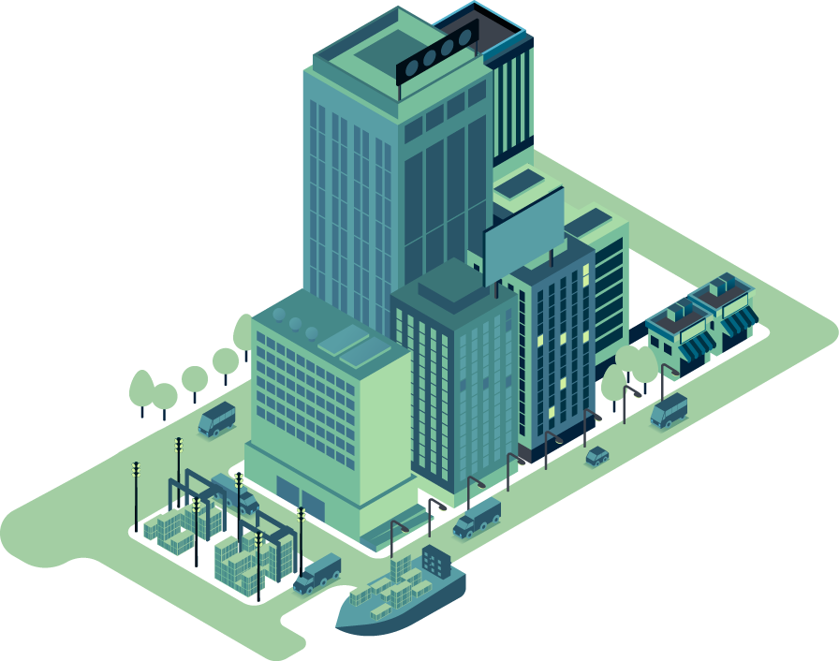
“This is a quote. Words full of wisdom that someone important said and can make the reader get inspired.”
—SOMEONE FAMOUS

Slide 7
project schedule
Task 1
December
Despite being red, Mars is a cold place, not hot
Task 2
January
Mercury is the smallest planet in our Solar System
Task 3
March
Jupiter is the biggest planet in our Solar System
Task 4
May
Saturn is composed mostly of hydrogen and helium
Task 5
July
Neptune is the farthest planet from the Sun

Slide 8
checklist
Here you can describe the state of your task 1
Here you can describe the state of your task 2
Here you can describe the state of your task 3
Here you can describe the state of your task 4
Here you can describe the state of your task 5

Slide 9
project timeline
PHASE 1
Venus has a beautiful name, but it’s terribly hot
PHASE 2
Despite being red, Mars is a cold place, not hot
PHASE 3
Mercury is the closest planet to the Sun
PHASE 4
Jupiter is a gas giant and the biggest planet in our Solar System

Slide 10
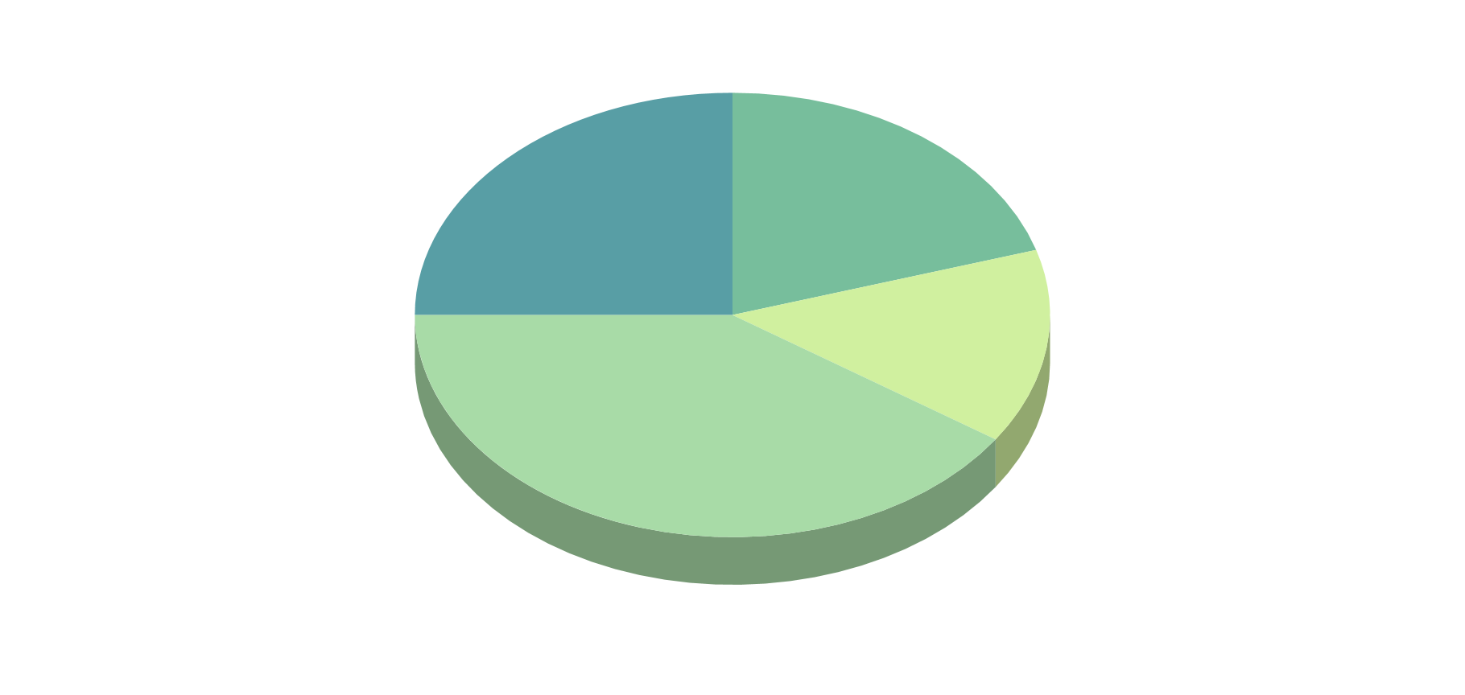
kpi dashboard
BUDGET
90%
80%
Mars
Venus
40%
EVOLUTION
Mercury
Jupiter
If you want to modify this graph, click on it, follow the link, change the data and replace it
DATA
40M
12
70M
Revenue
Awards won
Users
Venus
Mars
Mercury

Slide 11
status report
All the project risks are under control
The project schedule is on track
Resourcing is adequate
The project is within budget

Slide 12

raid summary
RISKS
ISSUES
Neptune is the farthest planet from the Sun and the fourth-largest in our Solar System
Mercury is the closest planet to the Sun and also the smallest one in our Solar System
ASSUMPTIONS
DEPENDENCIES
Despite being red, Mars is a cold place, not hot. It’s full of iron oxide dust, giving the planet its reddish cast
Jupiter is the biggest planet in our Solar System and the fourth-brightest object in the sky

Slide 13


where we are
where we want to be
Mercury is the closest planet to the Sun and the smallest one in our Solar System—it’s only a bit larger than our Moon. The planet’s name has nothing to do with the liquid metal since it was named after the Roman messenger god
Venus has a beautiful name and is the second planet from the Sun. It’s terribly hot—even hotter than Mercury—and its atmosphere is extremely poisonous. It’s the second-brightest natural object in the night sky after the Moon

Slide 14
upcoming events
MERCURY
FEB 27
VENUS
MAY 13
MARS
JUN 10
Mercury is the closest planet to the Sun and the smallest one in our Solar System—it’s only a bit larger than our Moon
Venus has a beautiful name and is the second planet from the Sun. It’s terribly hot, even hotter than Mercury
Despite being red, Mars is a cold place, not hot. It’s full of iron oxide dust, which gives the planet its reddish cast

Slide 15
thanks
Does anyone have any questions?
addyouremail@freepik.com
+91 620 421 838
yourcompany.com
facebook.com/Freepik
company/freepik-company
@Freepik_Vectors

Slide 16
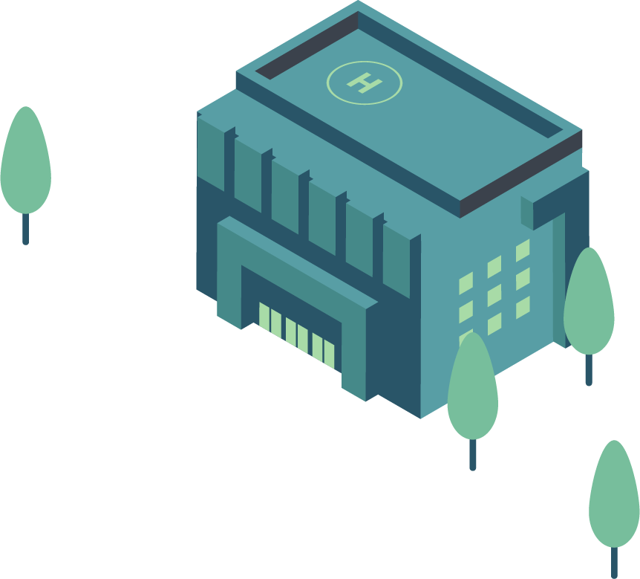
credits
This is where you give credit to the ones who are part of this project.
Presentation template by Slidesgo
Icons by Flaticon
Infographics by Freepik
Author introduction slide photo created by Freepik
Text & Image slide photo created by Freepik.com

Slide 17
resources
Did you like the resources on this template? Get them for free at our other websites.
VECTORS
Isometric gradient infographic element collection
Isometric gradient infographic element collection II
Isometric gradient infographic element collection III
Isometric gradient infographic element collection IV
Isometric gradient infographic element collection V
Isometric smart city background
Isometric landing page
Isometric landing page II
Isometric infographic with timeline background
Isometric smart city background
Isometric smart city background II
Isometric smart city background III
Pack business 329
Pack user interface 47
Icon suitcase

Slide 18
Instructions for use
In order to use this template, you must credit Slidesgo by keeping the Credits slide.
You are allowed to:
- Modify this template.
- Use it for both personal and commercial projects.
You are not allowed to:
- Sublicense, sell or rent any of Slidesgo Content (or a modified version of Slidesgo Content).
- Distribute Slidesgo Content unless it has been expressly authorized by Slidesgo.
- Include Slidesgo Content in an online or offline database or file.
- Offer Slidesgo templates (or modified versions of Slidesgo templates) for download.
- Acquire the copyright of Slidesgo Content.
For more information about editing slides, please read our FAQs:
https://slidesgo.com/faqs

Slide 19
Fonts & colors used
This presentation has been made using the following fonts:
Unica One
(https://fonts.google.com/specimen/Unica+One)
Lato
(https://fonts.google.com/specimen/Lato)
#589ea5
#77be9c
#a8dba7
#d0f09f

Slide 21
Use our editable graphic resources...
You can easily resize these resources, keeping the quality. To change the color, just ungroup the resource and click on the object you want to change. Then, click on the paint bucket and select the color you want. Don’t forget to group the resource again when you’re done.

Slide 22
...and our set of editable icons
You can resize these icons, keeping the quality.
You can change the stroke and fill color; just select the icon and click on the paint-bucket/pen.

Slide 23
Business Icons

Slide 24
Avatar Icons

Slide 25
Creative Process Icons

Slide 26
Educational Process Icons

Slide 27
Help & Support Icons

Slide 28
Medical Icons

Slide 29
Nature Icons

Slide 30
Performing Arts Icons

Slide 31
SEO & Marketing Icons

Slide 32
Teamwork Icons

Slide 33


